Slide 1

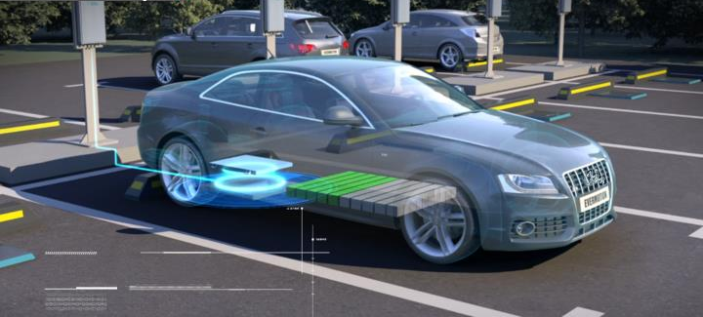
KOLHAPUR INSTITUTE OF TECHNOLOGY’S COLLEGE OF ENGINEERING KOLHAPUR
Wireless EV Charging System
Presented by :
Shubham Gaikwad (B05)
Vrishal Chandawarkar (B06)
Krushnaraj Jagtap (B07)
Abhishek Gaikwad (B08)
Name of guide:
Mrs. Varsha Suryavanshi

Slide 2
Contents
Problem Statement
Objective
Introduction
Block Diagram
Working
EV Data
Research Work
Working Photo
Conclusion
References

Slide 3
Problem Statement
To provide a hassle free electric vehicle charging system and reduce human efforts.

Slide 4
Objective
To make a hassle free wireless EV charging station
Also guide the driver with necessary information such as the amount of payment that needs to be done
To reduce human efforts by sensor based wireless charging

Slide 5
Introduction
There are some issues with the plug in charging methods:
Thick Cables and Connectors: Existing solutions require bulky charging cables and connectors.
Manual Connection: Users must manually connect the charger to both the power source and the device.
Risk of Short Circuit: Factors like temperature, ground contact, or equipment wear can lead to short circuits or insulation deterioration, posing electric shock risks.

Slide 6
Introduction
To address this issues, a fully wireless EV charging system has been designed. This system aims to eliminate the need for manual charger plugging by automatically connecting the vehicle to the charging station. Additionally, it will provide drivers with information on their total electricity bill. In the future, an automated billing system, akin to "Fasttag," will be introduced.

Slide 7
List of Components
IR Proximity Sensor
LCD Display (16x2) - 2
5V Relay module (PCB Mounted) - 2
AT89S51 Microcontroller
PIC 16F877A
Voltage sensor module – 2
7805 IC regulator – 2
Solar panel (10W)
Batteries
Crystal Oscillators
Other components (resistors, capacitors, reset switches, etc.)

Slide 8
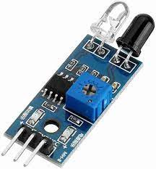
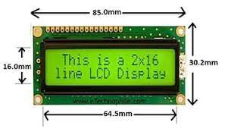
Components
1. IR Proximity Sensor
Specifications :
Supply Voltage : 5V
Output Voltage : 5V
Range : 15 to 20 cm
2. LCD Display
Specifications :
Operating Voltage: 4.7V to 5.3V
Operating Current 1mA (without backlight)
Can display (16x2) 32 Alphanumeric Characters
Works in both 8-bit and 4-bit Mode

Slide 9
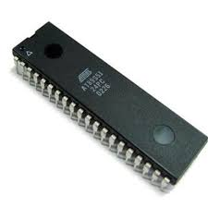
Components
3. AT89S51 Microcontroller
Specifications :
8 bit Microcontroller
Operating Frequency Max: 24MHz
Program Memory Size: 4KB
No. of Pins: 40Pins
No. of I/O's: 32I/O's
Interfaces: SPI, UART
RAM Memory Size: 128Byte
Supply Voltage : 4V to 5V
Interrupts : INT0 and INT1

Slide 10
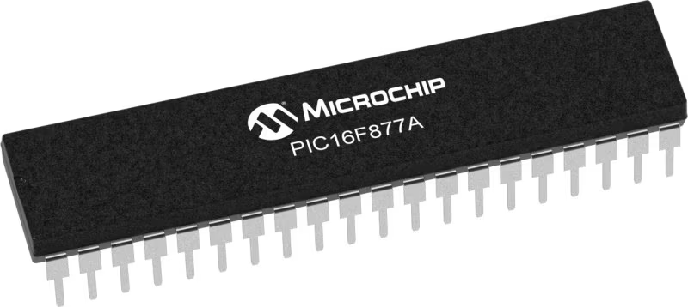
Components
4. PIC 16F877A Microcontroller
Specifications :
16 bit Microcontroller
Operating Frequency Max: 20MHz
Program Memory Size: 14KB
Data Memory : 256 bytes
No. of Pins: 40 Pins
Operation Voltage : 2V to 5.5V
8 channels of 10 bit Analog-to-Digital Converter
2 Comparators
UART Interfaces for Serial Communication

Slide 11
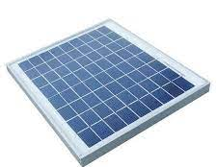
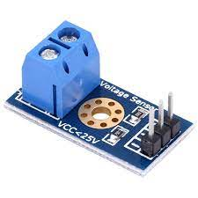
Components
5. Solar Panel
Specifications :
Peak power (Wp): 10 W ± 3%
Open circuit voltage (Voc): 20.6 V
Short circuit current (Isc): 0.61 A
Dimensions: 13.8 x 8.6 x 1.3 in
Operating voltage: 12 V
Number of cells: 36
6. Voltage Sensor Module
Specifications :
Range : 0 to 25V
Output Voltage : 0 to 5V

Slide 12
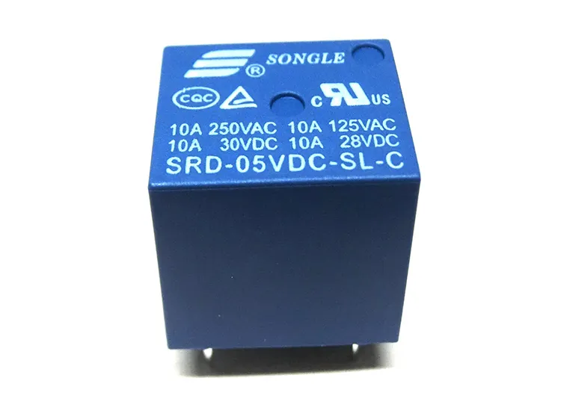
Components
7. PCB mounted relay
Specifications :
Trigger Voltage (Voltage across coil) : 5V DC
Trigger Current (Nominal current) : 70mA
Maximum DC load current: 10A @ 30/28V DC
Operating time: 10msec Release time: 5msec

Slide 13
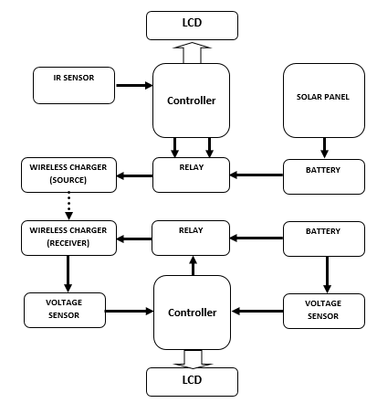
Block Diagram

Slide 14
Working
In this system we are having two sections, one section will be placed on the charging station and other part will be in the EV.
The charging station will be having a transmitting coil (primary) which will transmit the electrical energy in form of electromagnetic waves in the air. The system will be powered by a 12v battery. The battery will be charged using a solar panel.
There is also a IR proximity sensor which will detect the presence of an EV on the charging place. If EV is parked there then it will switch on the relay which will energize the charging coil. This will save the energy wastage.

Slide 15
Working
On the other hand the system inside the EV will also have a coil. This coil will act as a receiver and it will receive the electrical power transmitted by the transmitting coil. The energy then converted into DC and can be used for EV battery charging.
The EV driver will first receive a message on the LCD that the wireless charging is now available. Then he has to select whether he wants to charge the EV or not using switches to start and stop the charging.
Depending upon the time he will be charged. And the total payment will be displayed on the LCD. The driver will get all the necessary information on the same LCD inside the EV.
The relays will connect the charging coil to the battery.

Slide 16
Coil design specifications for WPT
Electric Vehicle | Battery Capacity (kWh) | Charging Time (10% to 80%) | Power (kW)
Tata Nexon | 30.02 to 40.5 | 60 mins | 50
Tata Tiago | 19.2 to 24 | 58 mins | 25
Tata Tigor | 26 | 59 mins | 25
MG Comet EV | 17.3 | 3.5 hrs | 7.4 AC
MG ZS EV | 50.3 | 63 mins | 50
Hyundai Ioniq 5 | 72.6 | 18 mins (350 kW DC) | 350
 |  | 43 mins 30s (50 kW DC) | 50
Kia EV6 | 77.4 | 63 mins (50 kW) | 50
 |  | 16 mins (233 kW) | 233
Mahindra XUV400 EV | 34.5–39.4 | 50 mins | 50
Table.1 Electric vehicles data
To decide the amount of transmitting power and battery storage for charging station, we need to analyse the data of various electric vehicles and acknowledge their charging time, battery capacity.

Slide 17
Rx and Tx Efficiency
Sr.No | Distance between Tx and Rx Coil (Cm) | Output Voltage Rx (V) | Output Current Rx (A) | Efficiency (%)
1 | 0.25 | 5.20 | 2.60 | 93.88
2 | 0.5 | 5.19 | 2.32 | 83.61
3 | 0.75 | 5.19 | 1.90 | 64.47
4 | 1 | 5.19 | 1.14 | 41.08
5 | 1.25 | 5.19 | 0.84 | 30.27
6 | 1.5 | 5.18 | 0.20 | 7.20
We are studying past research to develop our own transmitter and receiver coils. We're figuring out the best distance between them to make them work better. Here's our result
The input voltage and current given to the transmitting coil are 12 V and 1.2 A, respectively. The output voltage and current obtained at the receiving coil are as follows:

Slide 18
Research work
Formulas Referred:
1) Q(coil quality)= 2𝜋𝑓𝐿/𝑅
2)ƛ(𝐿𝑜𝑠𝑠 𝐹𝑎𝑐𝑡𝑜𝑟) = 𝑘(𝐶𝑜𝑢𝑝𝑙𝑖𝑛𝑔 𝑓𝑎𝑐𝑡𝑜𝑟).𝑄(𝐶𝑜𝑖𝑙 𝑄𝑢𝑎𝑙𝑖𝑡𝑦).
3) Skin effect= √2𝜌/𝜋𝑓𝑢
4) Resonant frequency: Fr = 1/2𝜋√𝑙𝑐
Designing was based on following factors:
1) Output power (Expected): first step was to define expected output power so that all the
components can be selected as per required rating. In our case it was 5W.
2) Efficiency: We were expecting efficiency around 80-85% for 5 CM distance we got the same
as we got commercially made windings in our circuit.

Slide 19
3) Coil Quality: It was the part about material selection, we tried with different material like Singe stand copper wire, multistrand copper wire and lit z wire. Also coupling factor (k) matters a lot while designing coils.
4) Distance: We were aiming for average distance of 3CM and max distance of 5CM system gives best efficiency at 10mm
5) Input voltage: Input voltage were needed for good efficiency was 12V at input side as oursystem is solar based we used a 24W panel for good efficiency.

Slide 20
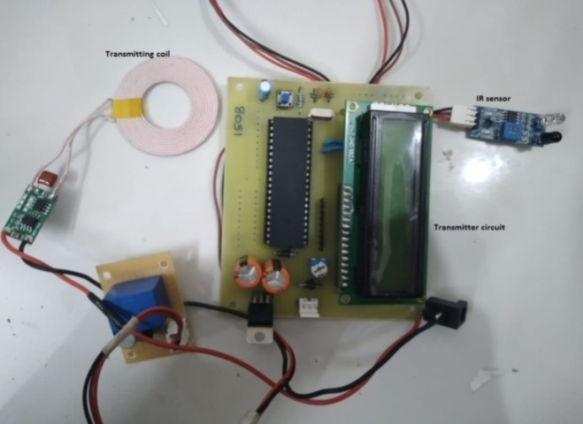
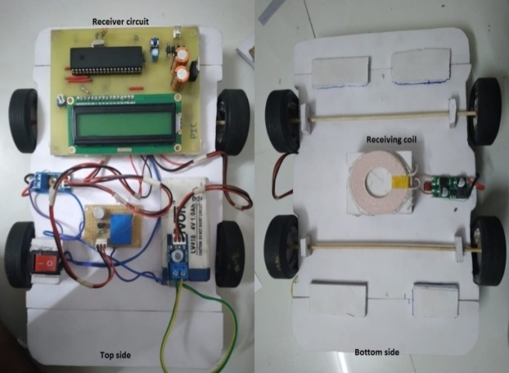
WORKING PHOTOS
Fig 4.1. Transmitter
Fig 4.2. Receiver Circuit

Slide 21
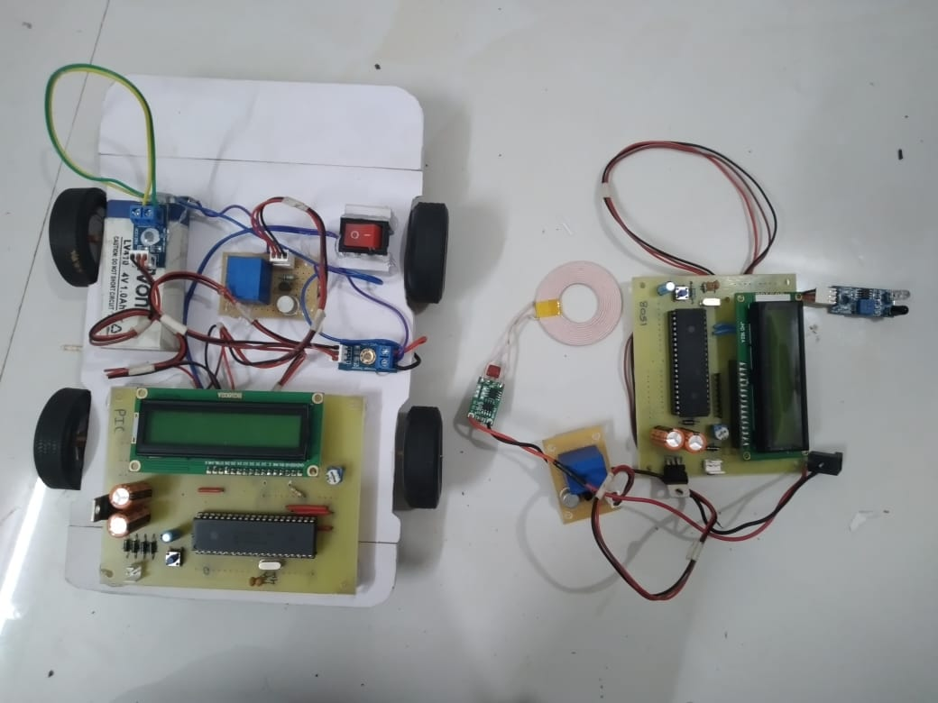
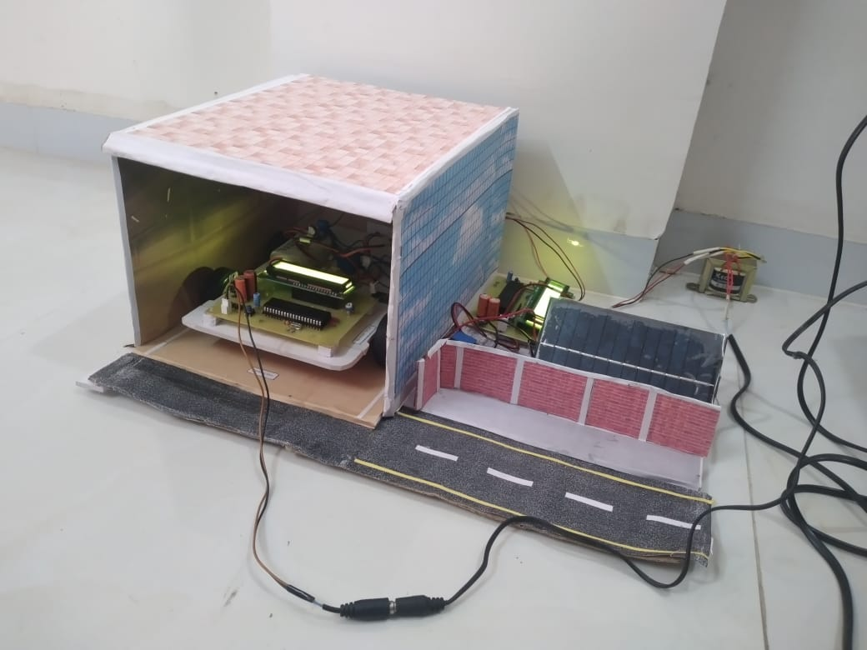
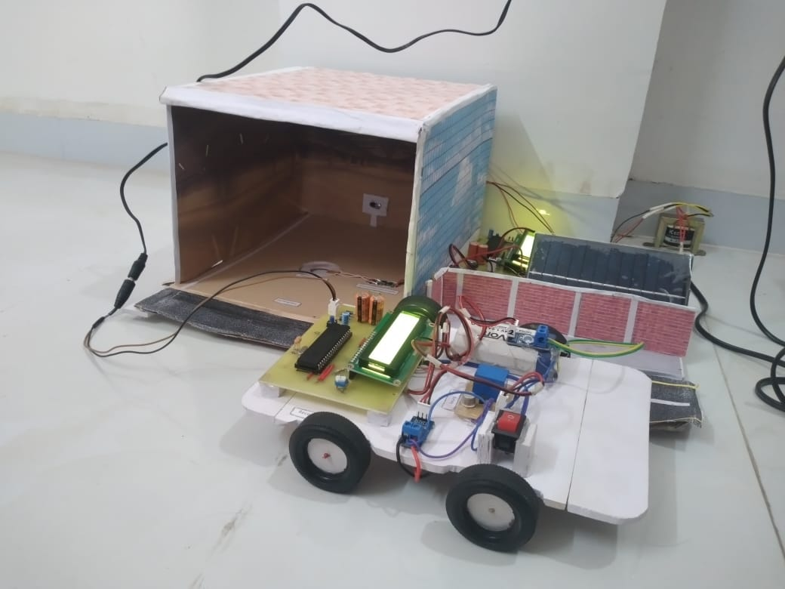
Fig 4.3. Transmitter and Receiver
Fig 4.4. Vehicle charging start
Fig 4.5. Vehicle is charged

Slide 22
Conclusion
This is the fundamental structure of the wireless EV charging system. It can automatically connect the vehicle to the wireless charging station, mitigating the shortcomings associated with wired or plug-in charging. Furthermore, it informs the driver about the total bill. However, despite its apparent ease and feasibility, this system faces several technical challenges, including issues such as the number of windings in the coil, required voltage, and the coil's shape for efficient power transfer. Research and experiments are being carried out to solve these issues.

Slide 23
References
Wireless Charging System for electric vehicle by Prof. Satisha Shetty
International Research Journal of Engineering on Wireless Charging Station.
Wireless Ev charging system for electric vehicles international journal February 2017.
IJERT ISSN: 2278-0181 Efficient wireless charging for electric vehicle.

Slide 24


